Slide 1
DATA SCIENCE Class 11: TYPES and Bases
Notes:
~15-20 min on initial stuff
Note: example DS problem…write down some features, how could you build a predictive model from these?

Slide 2
I. Organizing Data II. formats III. APIs [LAB] IV. Databases V. SQL [LAB] [Lab]
agenda
Notes:
All of our classes will involve some hands-on work (in the exercises section)

Slide 3
I. Organizing Data
INTRO TO DATA SCIENCE
Notes:
~15-20 min for this section?

Slide 4
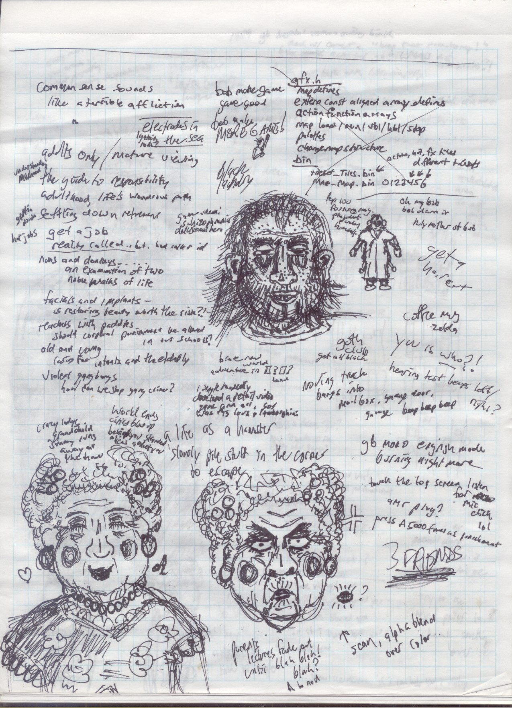
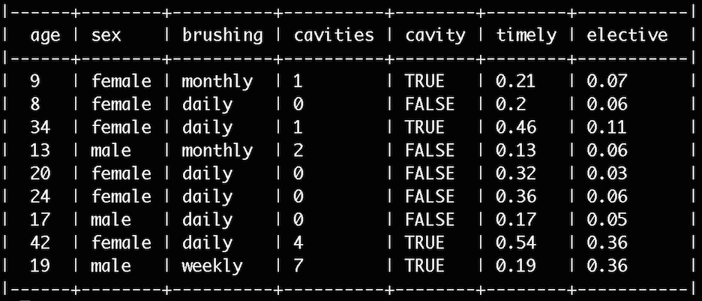
Organizing Data
Un-Structured Data
Structured Data
Notes:
This is pretty high level
Q: what kinds of tools & techniques do you think this means? (subject of this course…”useful” depends on the particular problem)
in general, DS is used to make intelligent decisions (frequently to satisfy business requirements)
Q: does anyone know of any examples?

Slide 5
Organizing Data
Tabular data
Nested data
Graph data

Slide 6
Organizing Data
Tabular data
Rows and Columns
Implicit or Explicit Schema (tidy or not)
Very common and well-handled by software

Slide 7
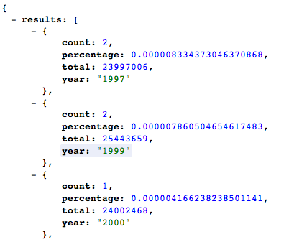
Organizing Data
Nested data
“Hierarchical”, “Tree”, “Object”
Often schema-less; multiple data types
Often natural and fairly common

Slide 8
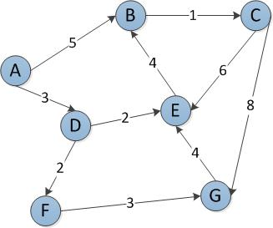
Organizing Data
Graph data
Nodes and Edges
Schema?
Appropriate when appropriate

Slide 9
II. Formats
INTRO TO DATA SCIENCE
Notes:
~15-20 min for this section?

Slide 10
Organizing Data
Tabular data
Nested data
Graph data

Slide 11
Organizing Data
Tabular data
Rows and Columns
Implicit or Explicit Schema (tidy or not)
Very common and well-handled by software

Slide 12
Organizing Data
Nested data
“Hierarchical”, “Tree”, “Object”
Often schema-less; multiple data types
Often natural and fairly common

Slide 13
Organizing Data
Graph data
Nodes and Edges
Schema?
Appropriate when appropriate

Slide 14
III. APIs [Lab]
INTRO TO DATA SCIENCE
Notes:
~15-20 min for this section?

Slide 15
IV. Databases
INTRO TO DATA SCIENCE
Notes:
~15-20 min for this section?

Slide 16
Organizing Data
Tabular data
Nested data
Graph data

Slide 17
Organizing Data
Tabular data
Rows and Columns
Implicit or Explicit Schema (tidy or not)
Very common and well-handled by software

Slide 18
Organizing Data
Nested data
“Hierarchical”, “Tree”, “Object”
Often schema-less; multiple data types
Often natural and fairly common

Slide 19
Organizing Data
Graph data
Nodes and Edges
Schema?
Appropriate when appropriate

Slide 20
V. SQL [Lab]
INTRO TO DATA SCIENCE
Notes:
~15-20 min for this section?

Slide 21
INTRO TO DATA SCIENCE

